Slide 1
School Science Teacher Workshop at Clayton, NC. July 12th, 2019 Topic: Genetics and Our Food Supply

Slide 2
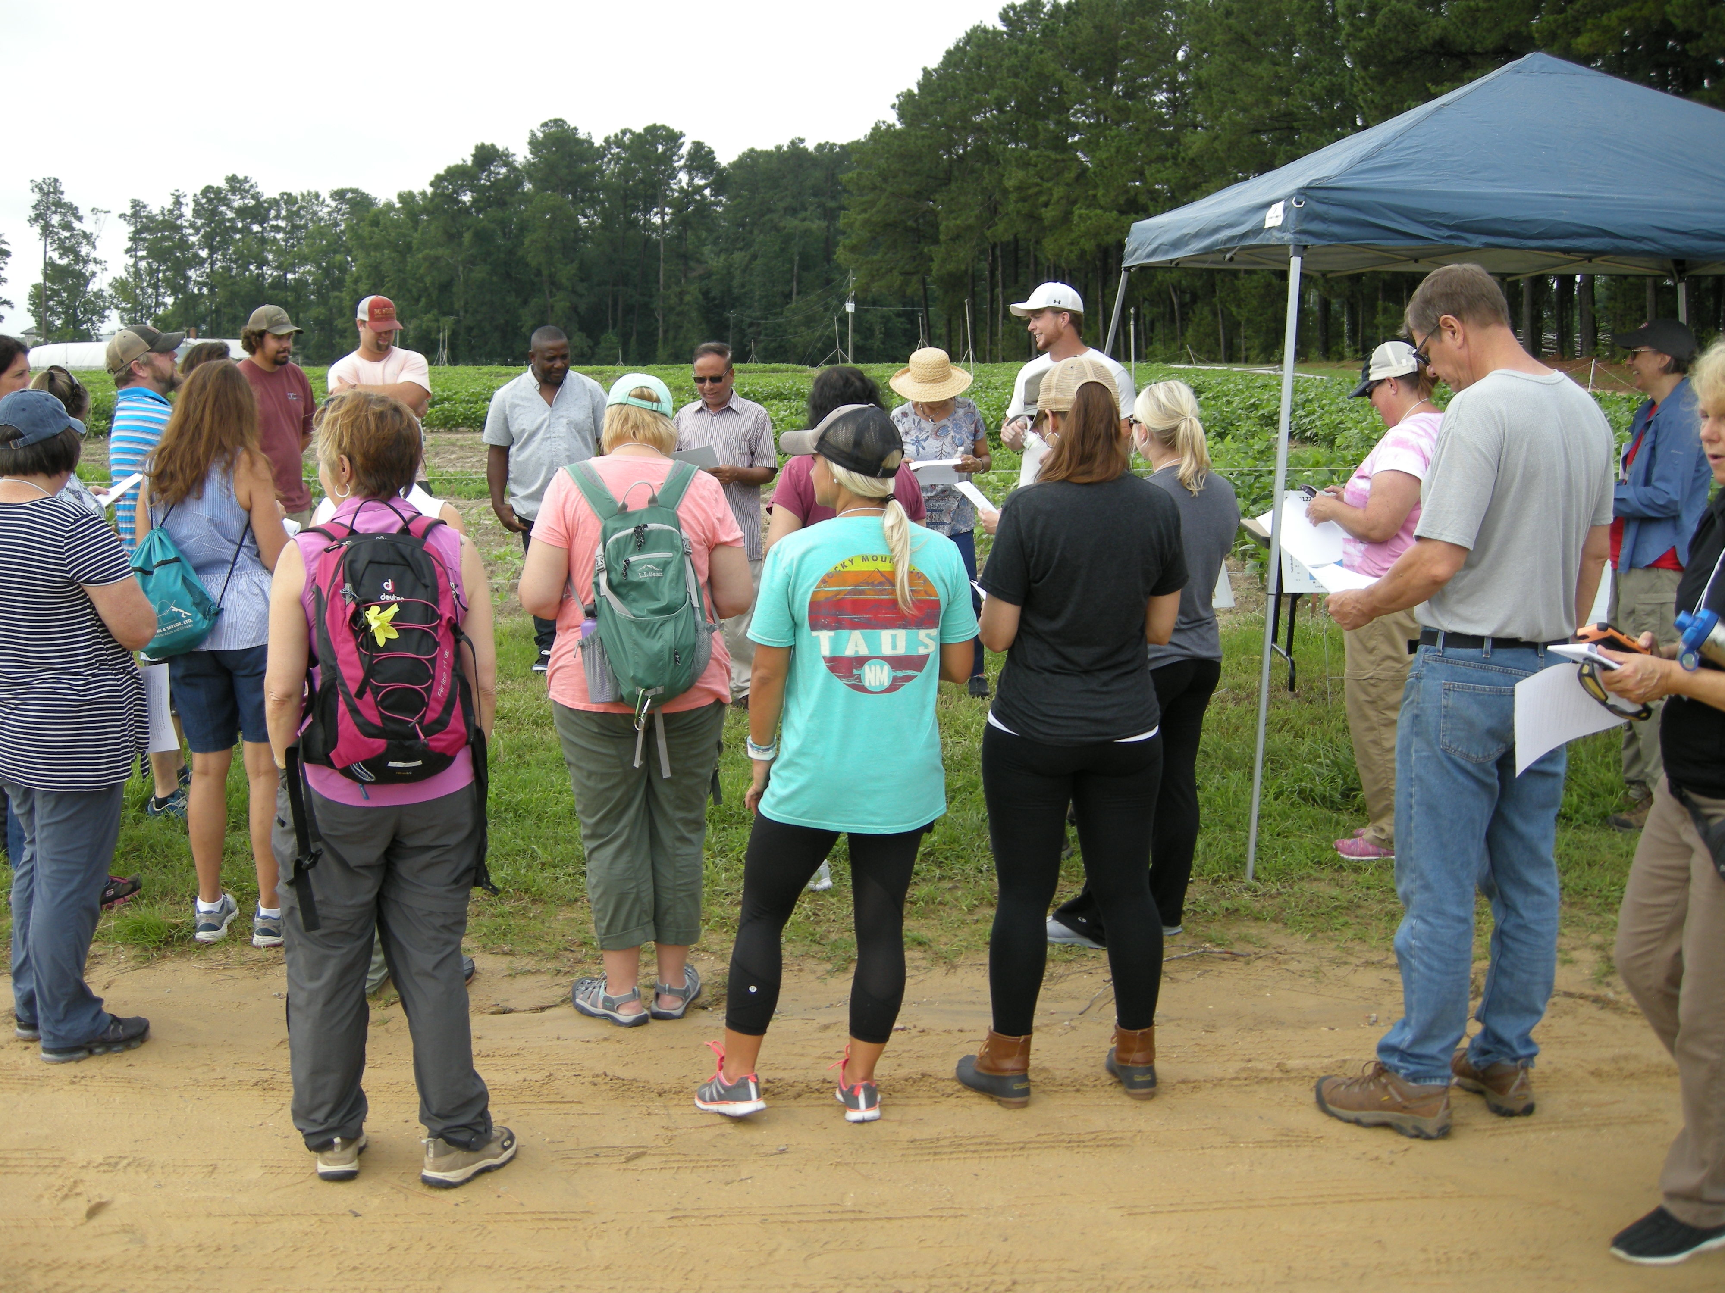
Rouf presenting the group with soybean facts

Slide 3
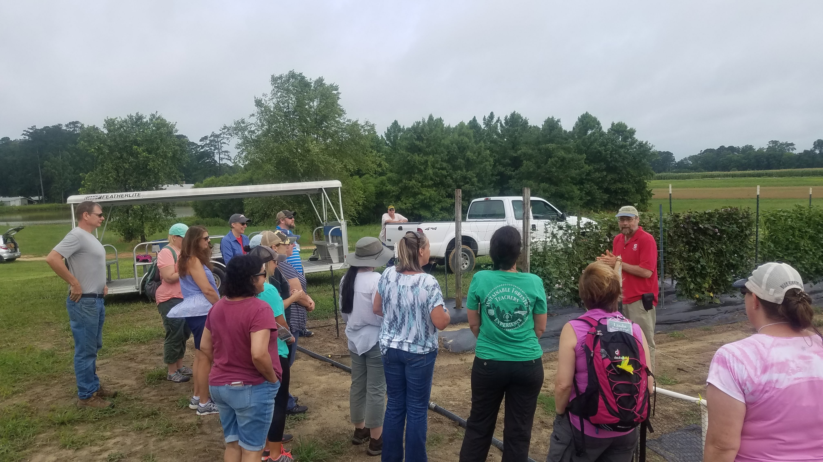
Ken Pecota explaining sweet potato breeding and the sweet potato nursery program at NCSU.

Slide 4
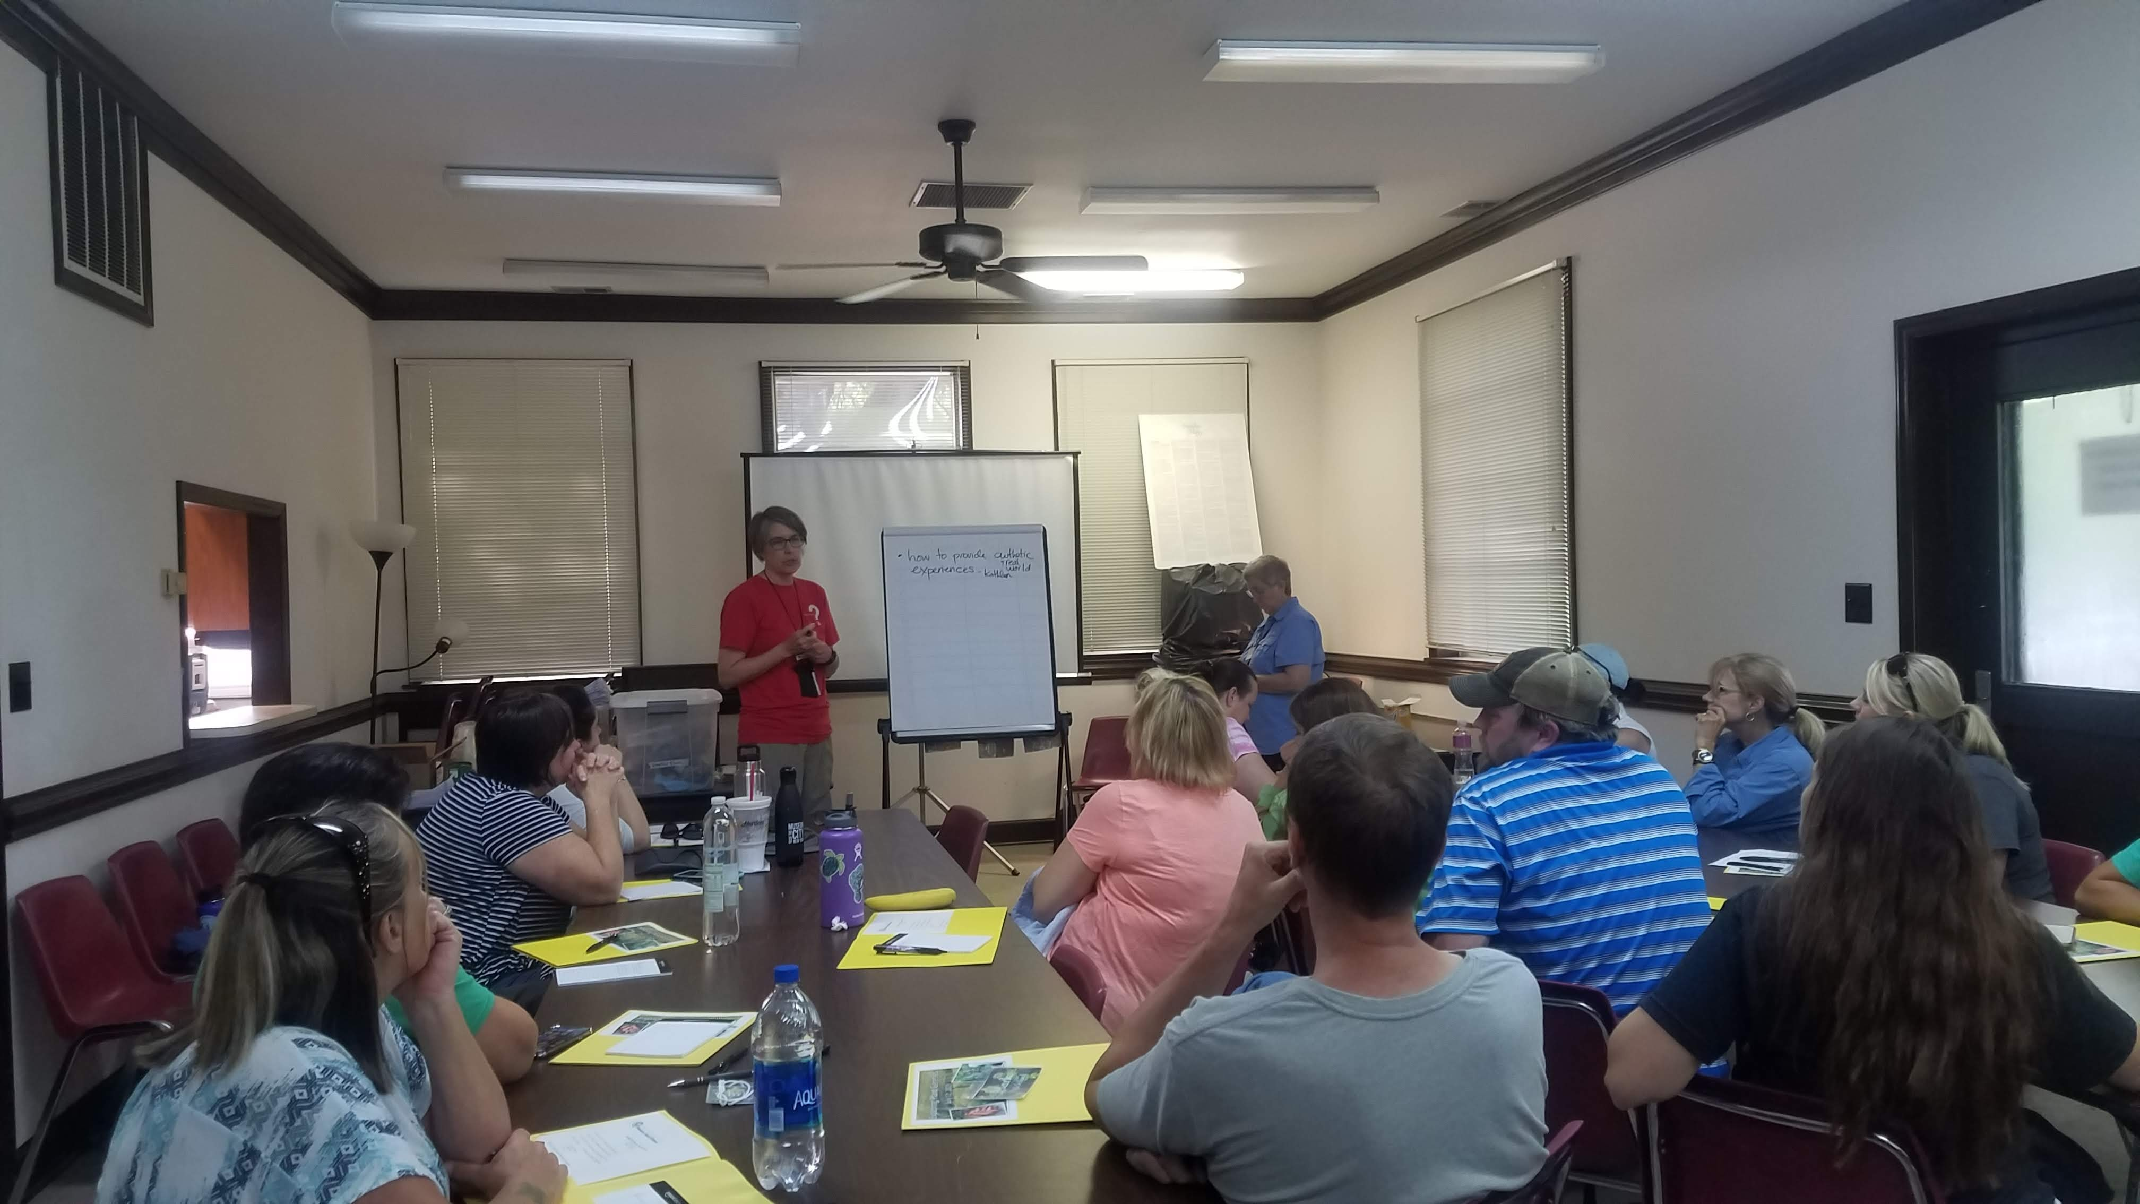
Getting away from the heat to learn more about agriculture.

Slide 5
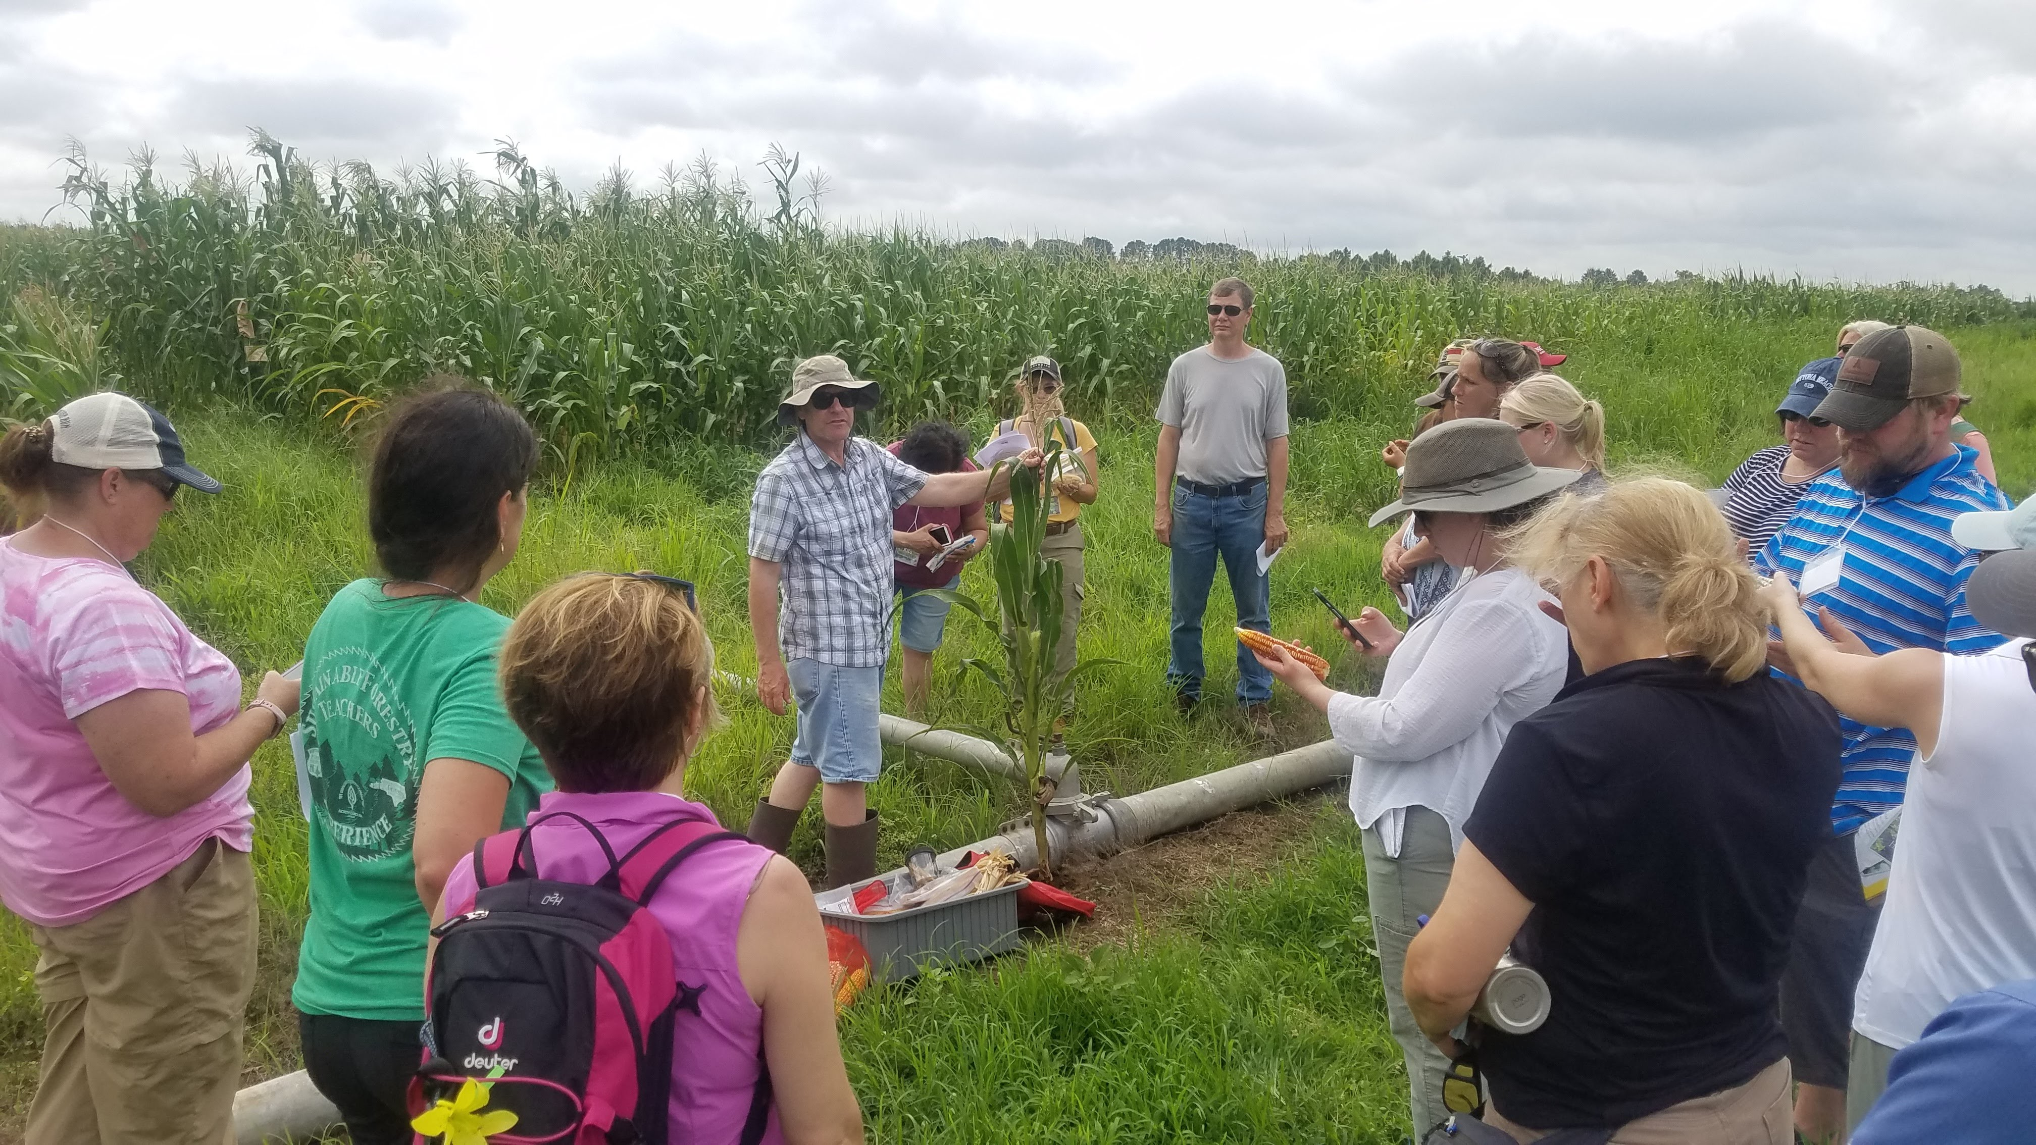
Peter Balint-Kurti demonstrating maize breeding for resistance to diseases and other traits.

Slide 6
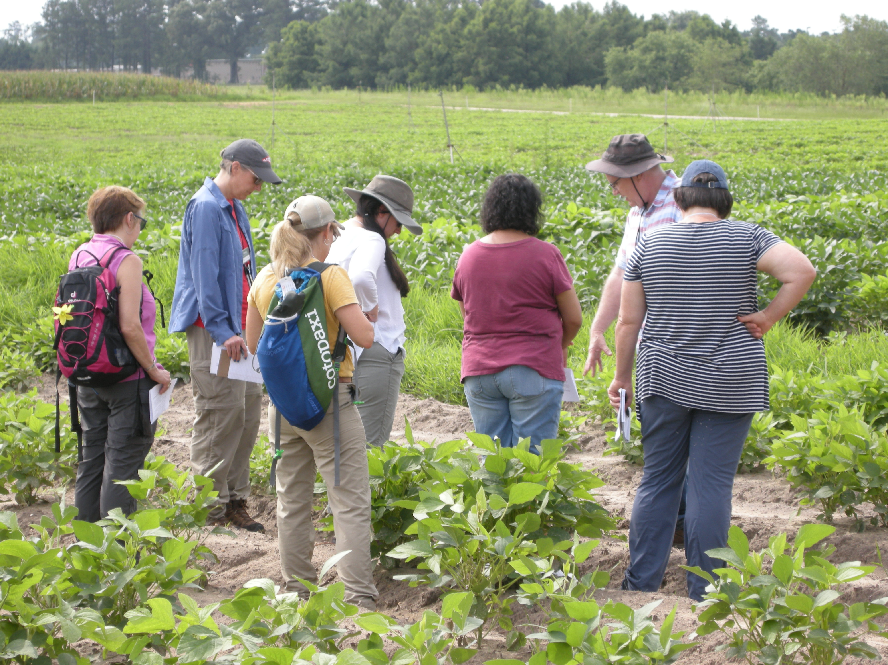
Earl T. showing soybean diversity using wild soybeans.
Wild Soybeans are much more diverse than cultivated soybeans!

Slide 7
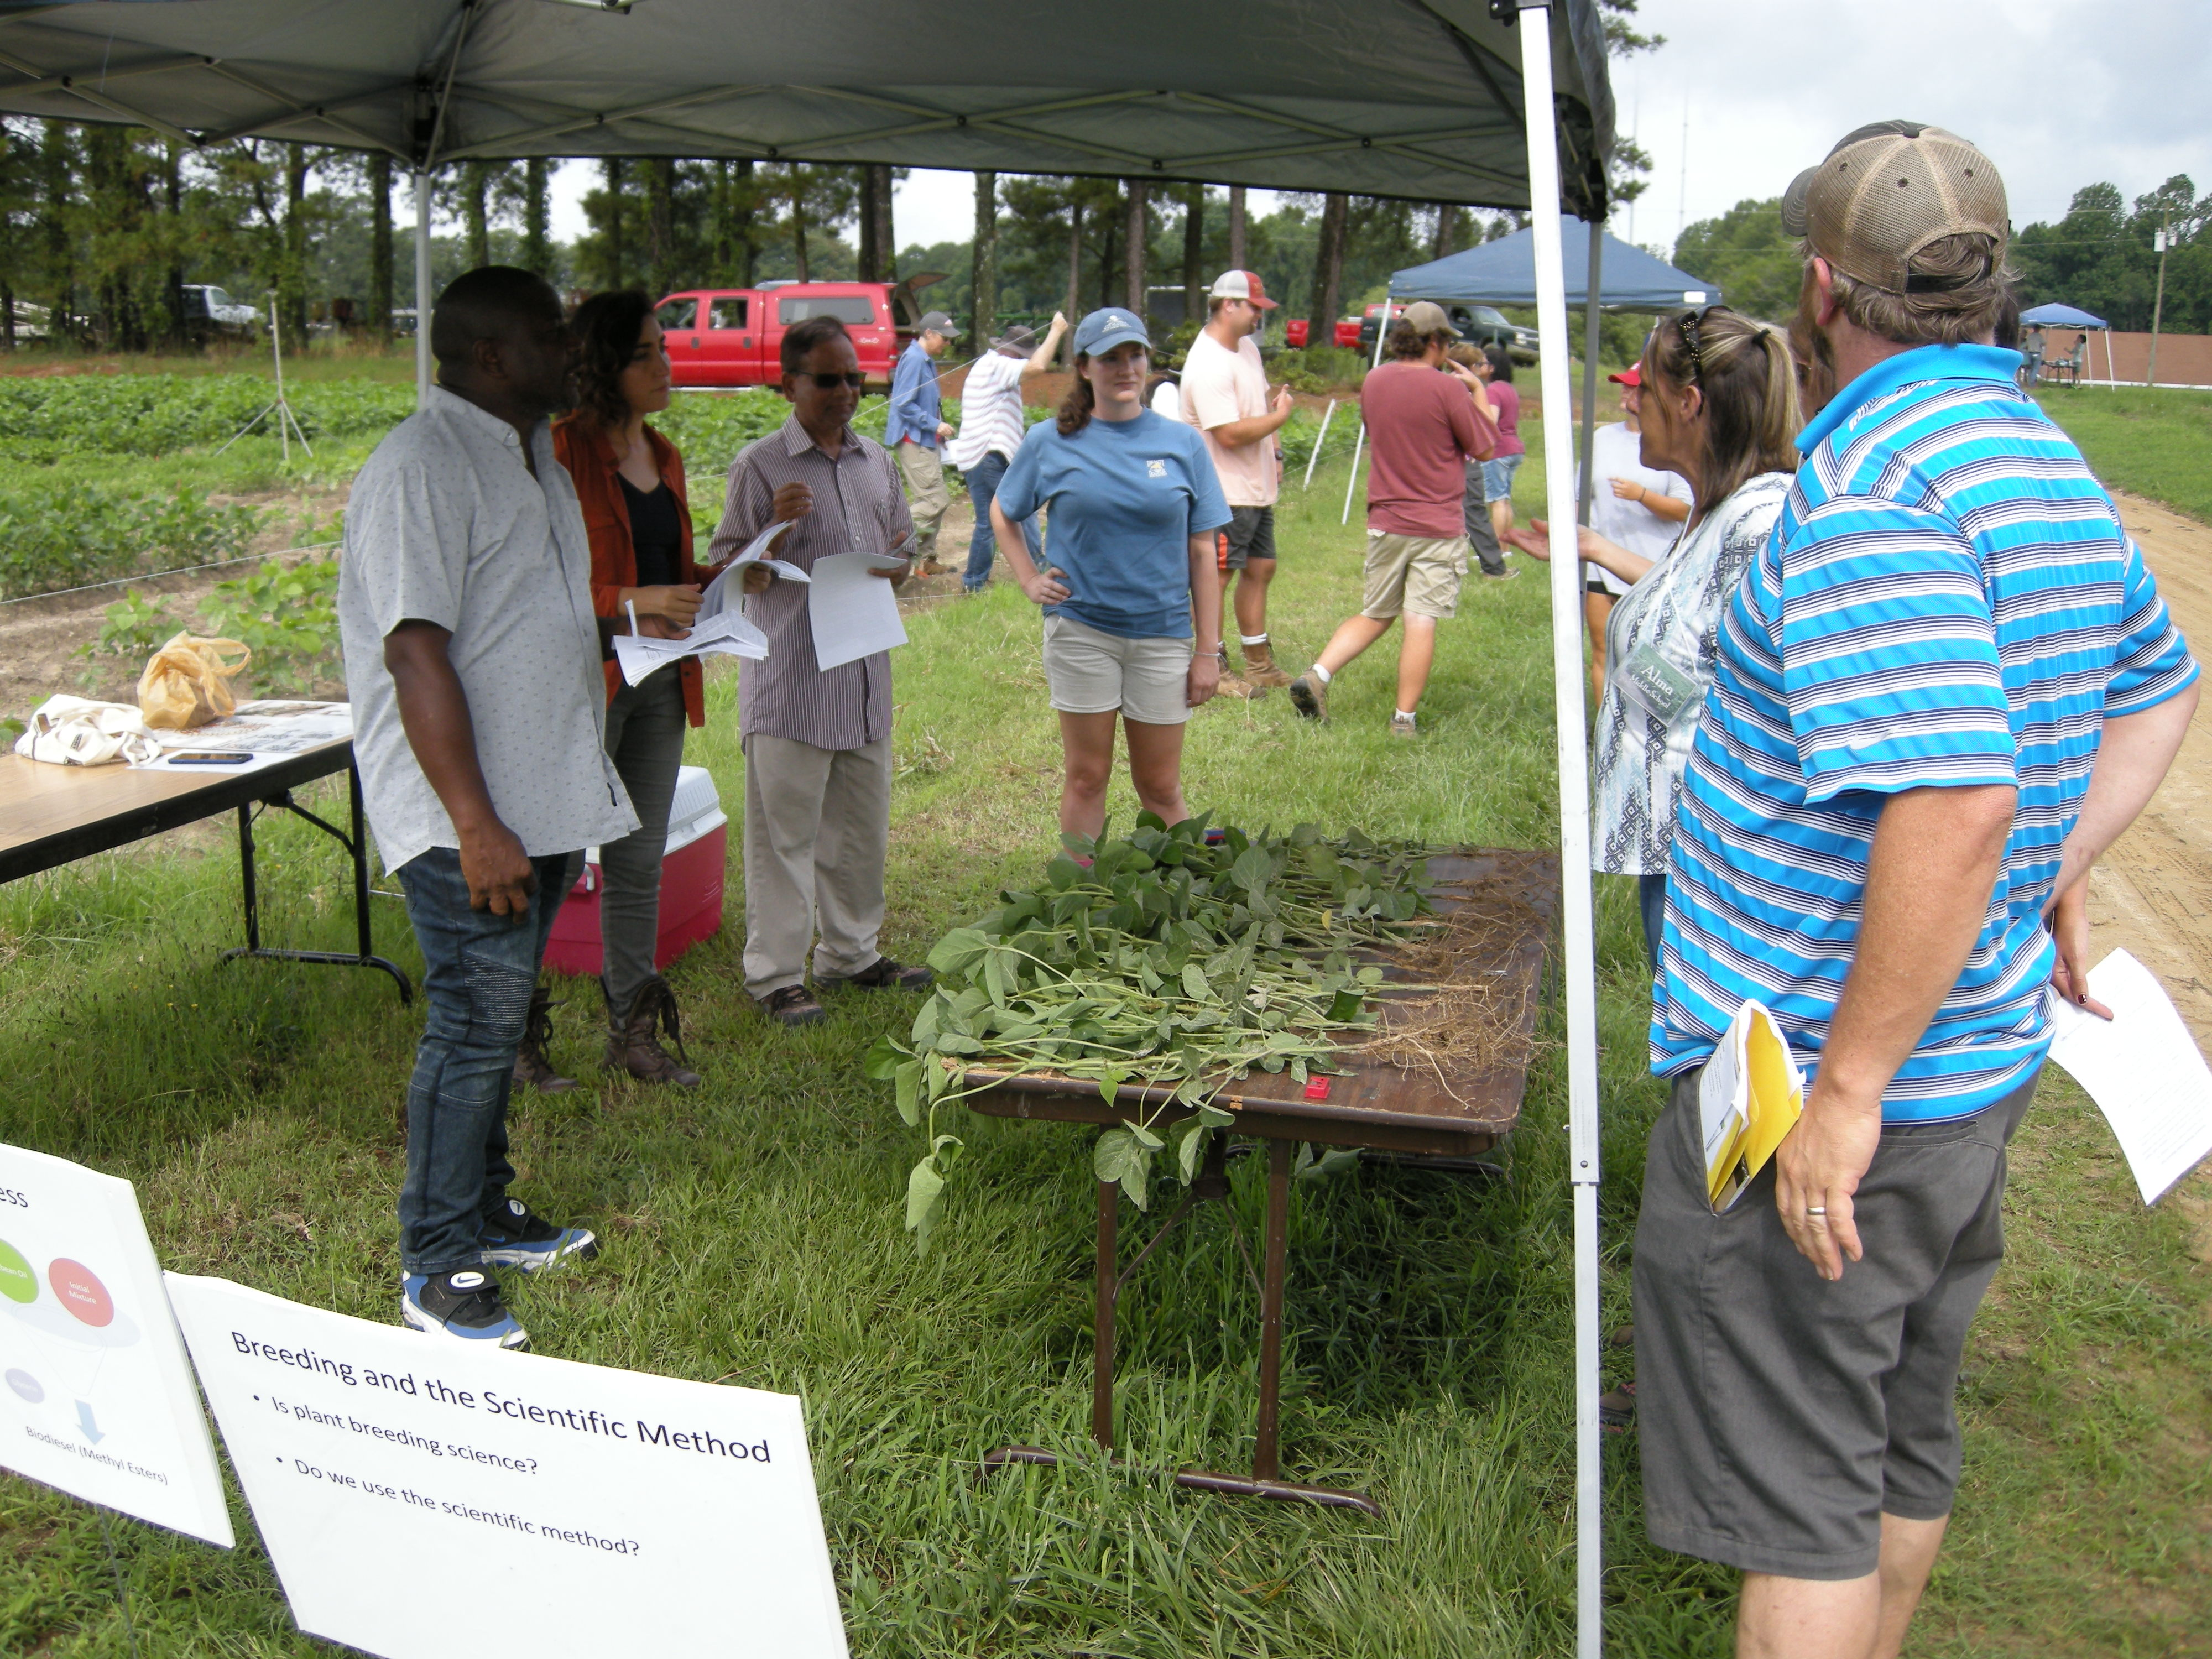
Laleh and Etone answering questions about soybean nodules and nitrogen fixation.

Slide 8
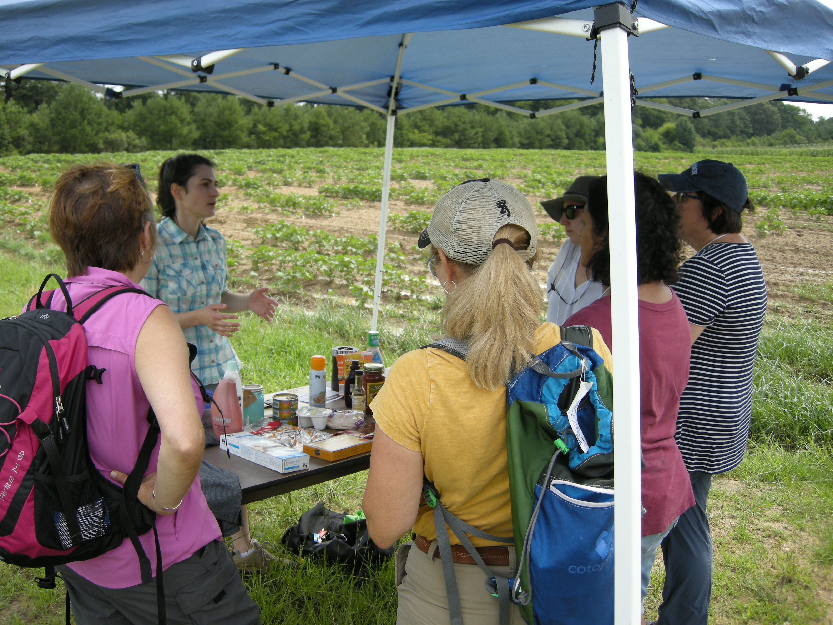
Anna Locke presenting products derived from soybeans.

Slide 9
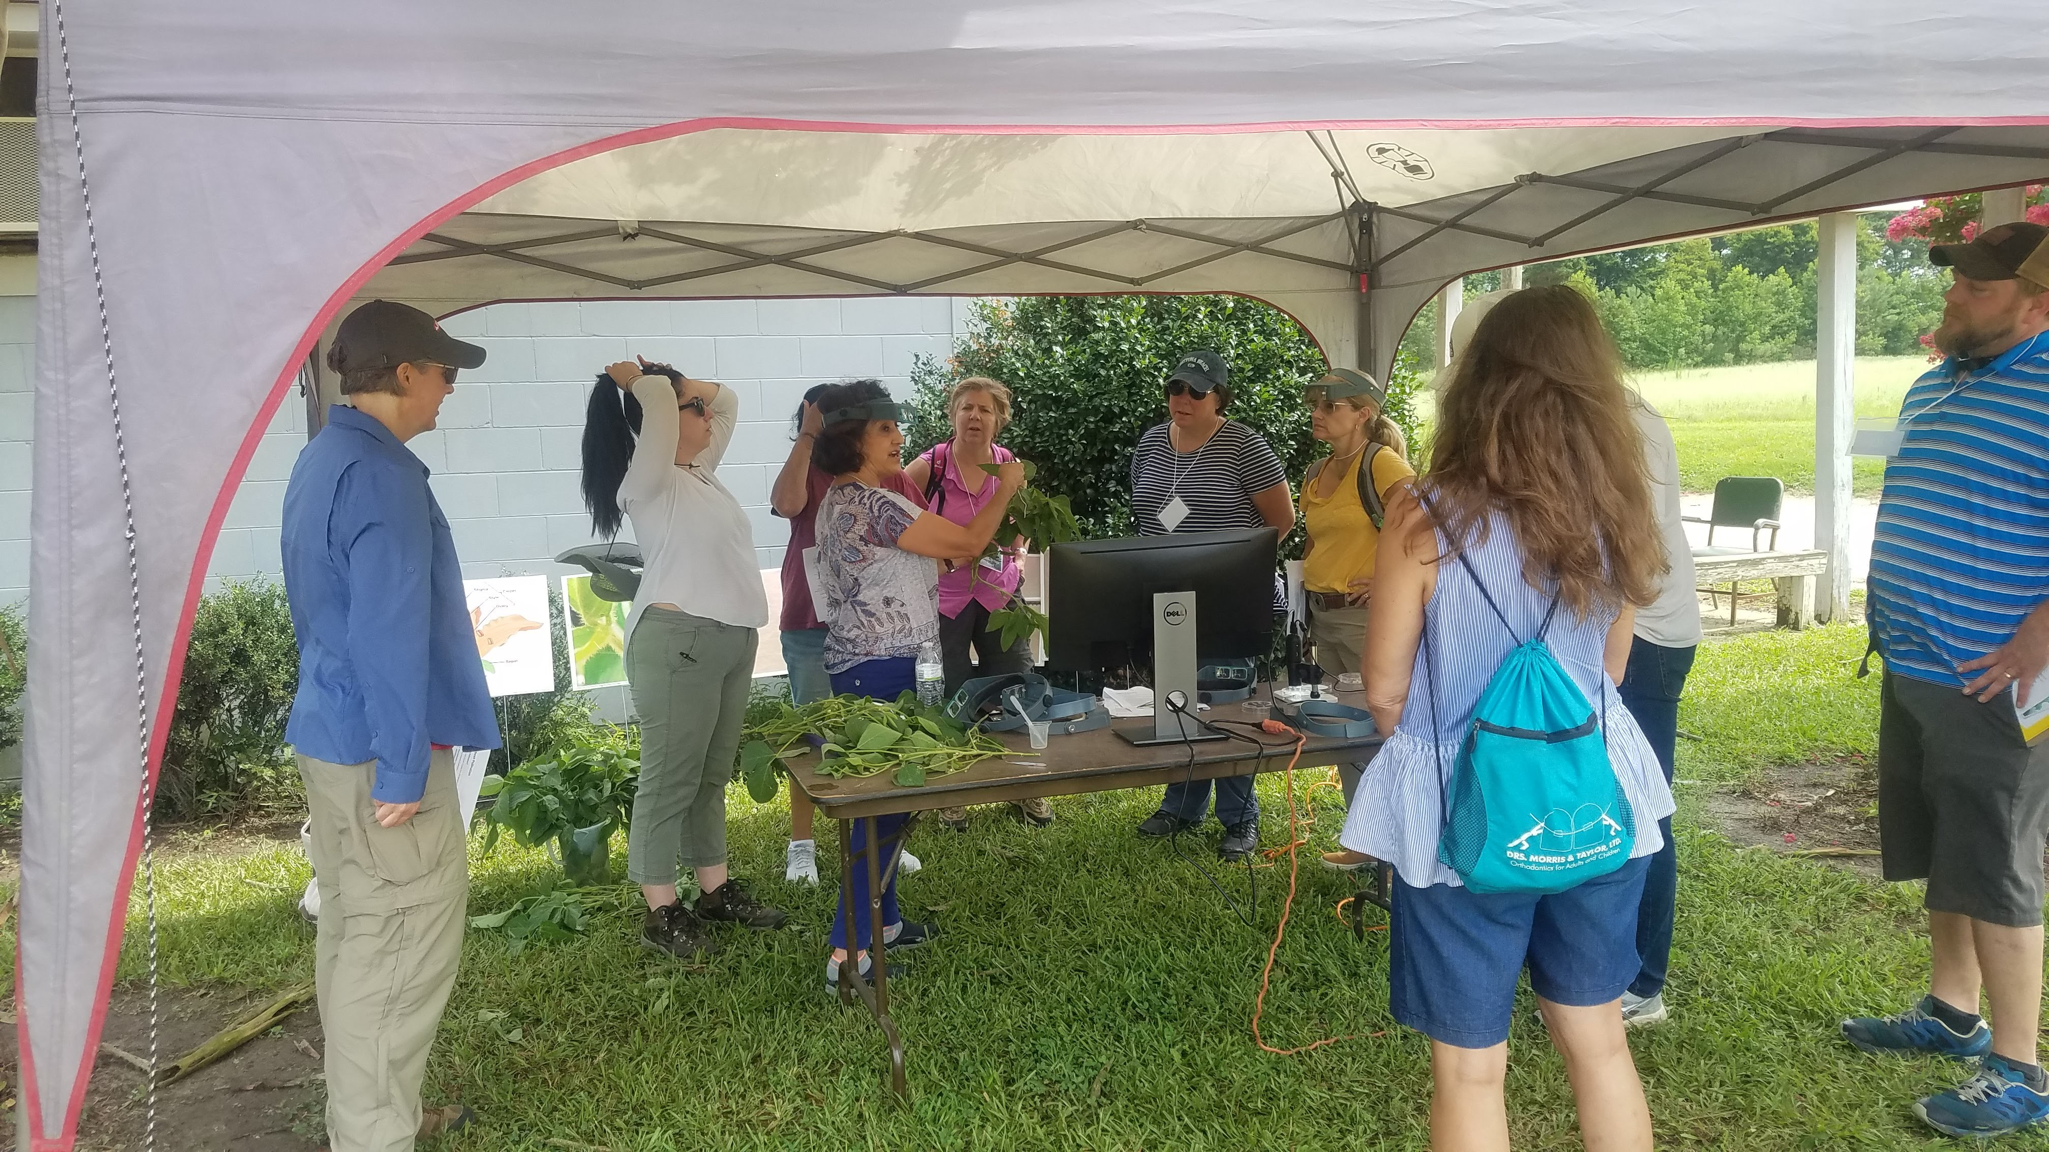
Margarita and Brant illustrating how to make crosses in soybean.

Slide 10
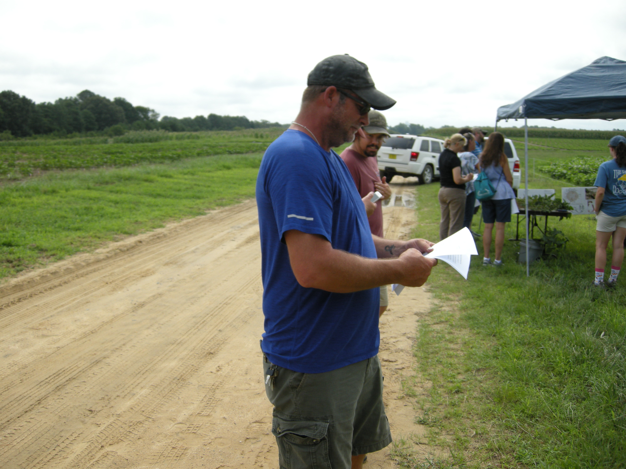
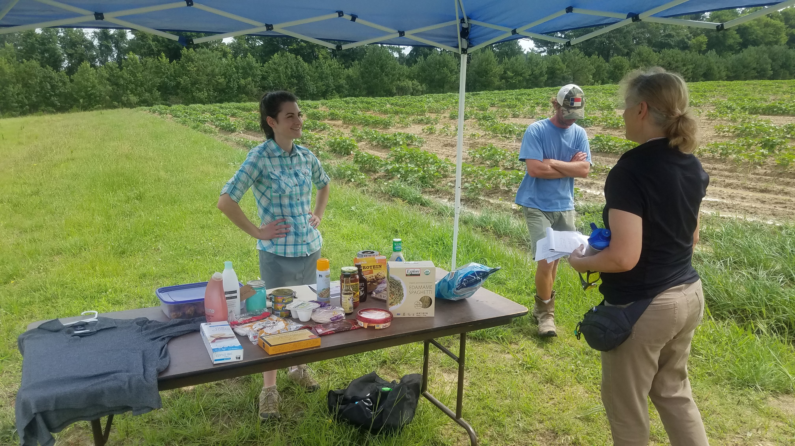
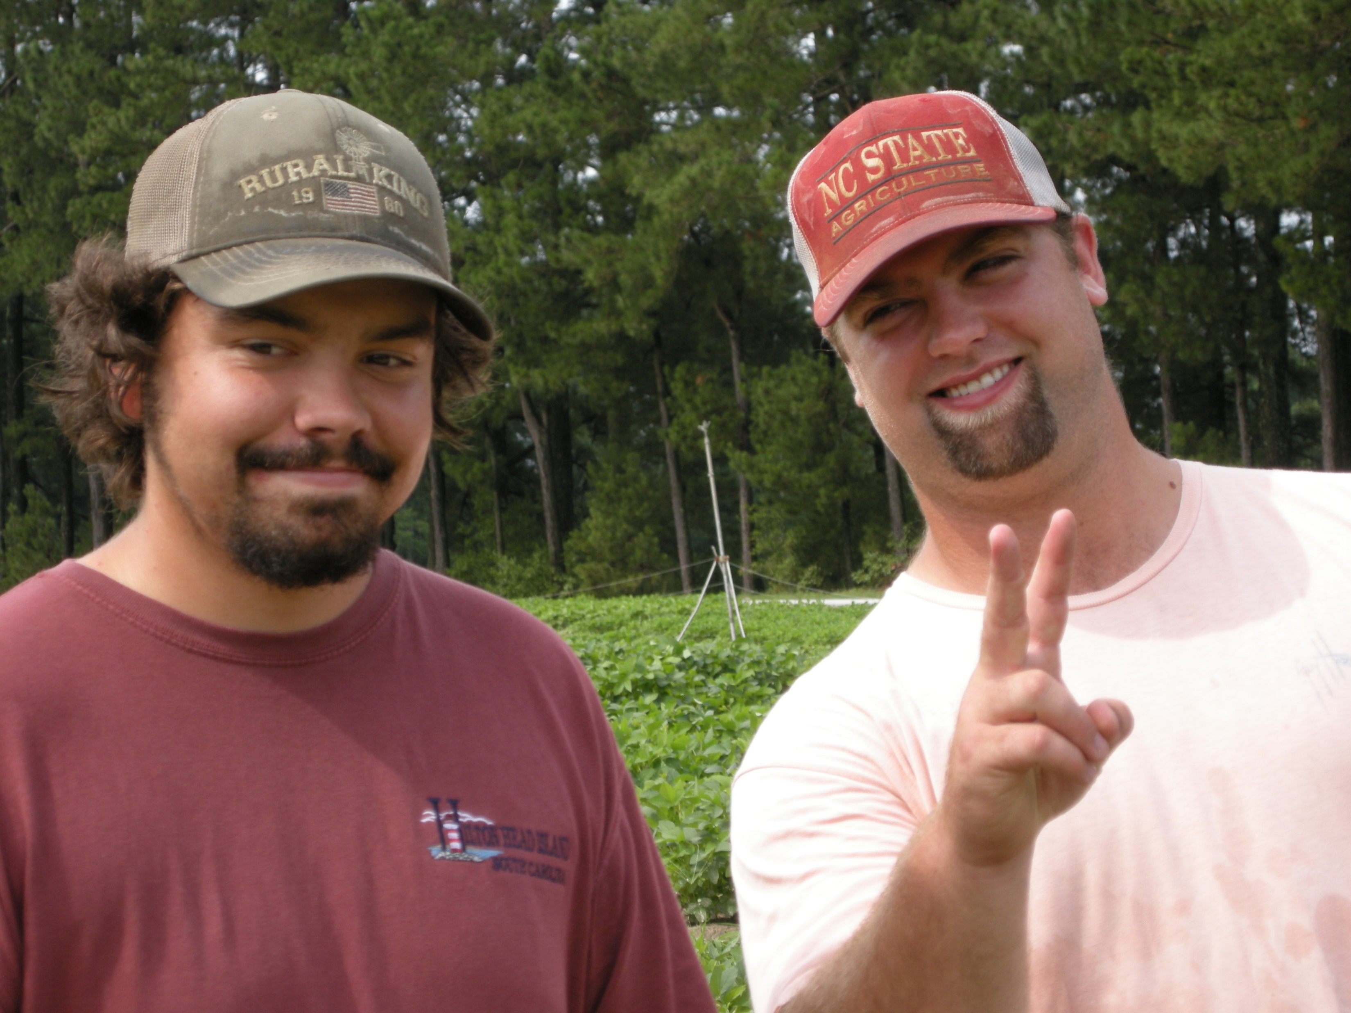
Paul, Hunter, Jason, and Cory making sure the entire event was running smoothly.

Slide 11
Thank you to: Peter and Jason for providing all the pictures

